Slide 1

Type Script
Day 2

Slide 2

Objectives
Understanding of Functions
Understanding of tsconfig.json file
Let, Var and Const in Type Script
Any Vs Unknown
Arrays in Type Script
Tuples in Array

Slide 3
Understanding of Functions
Creating and using functions is a fundamental aspect of any programming language, and TypeScript is no different.
TypeScript fully supports the existing JavaScript syntax for functions, while also adding type information and function overloading as new features.

Slide 4
Understanding of Functions
The syntax for creating functions in TypeScript is the same, except for one major addition: You can let the compiler know what types each argument or parameter should have. The following code block shows the general syntax for this, with the type declarations highlighted:
function functionName(param1: Param1Type, param2: Param2Type): ReturnType {
// ... body of the function
}
By considering above syntax, we will create very basic function:
function additionOfTwoNumbers(num1:number, num2:number):number {
return num1+num2}

Slide 5
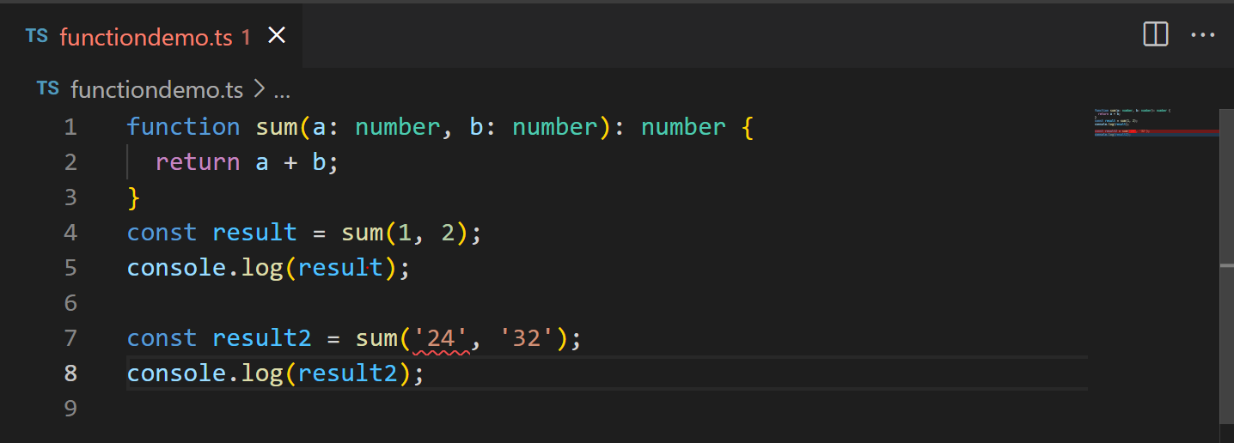
Understanding of Functions
Observe the code given below:

Slide 6
Understanding of Functions
If you called your function with a value that has a type other than expected by your function, the TypeScript Compiler (tsc) would give you the error 2345. Take the following call to the sum function:
const result2 = sum('24', '32');

Slide 7
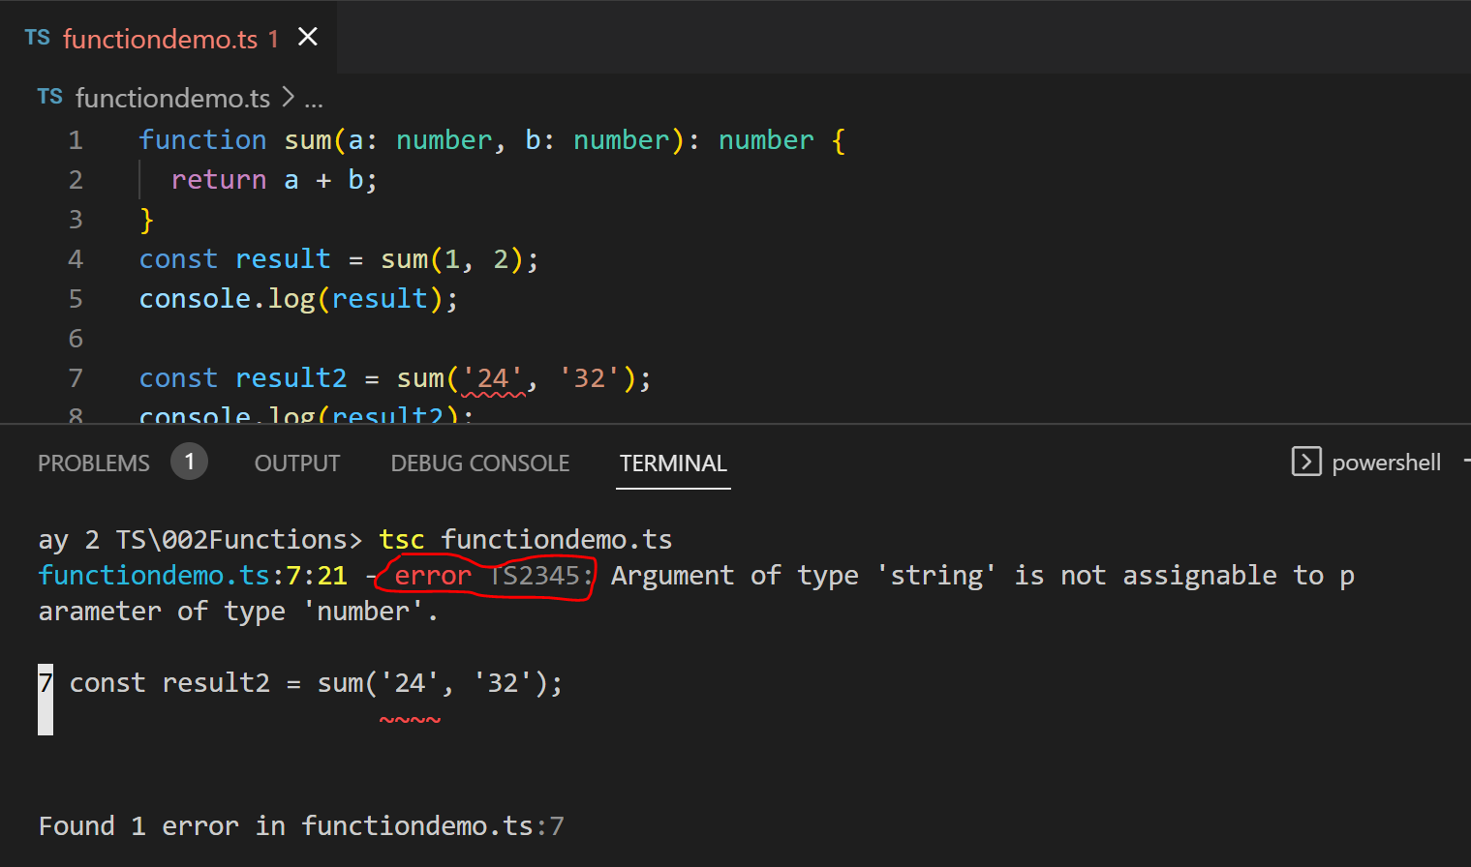
Understanding of Functions
You can see what error it will display in given below picture:

Slide 8
Understanding of Functions
You can see what error it will display in given below picture:

Slide 9
Understanding of Functions
We have already seen, that we can use some primitive types like string, number and boolean but we can also use user define type as type.
It is like non primitive data types in Java.
Let’s consider we will have to work with employee related data. So, we will create our type as employee.

Slide 10
Understanding of Functions
Example:
type Employee = {
firstName: string;
lastName: string;
};
You could create a function that returns the full name of the user like the following:
// function with employee type parameter and string return type
// even if we will remove string but also type script will infer return type of function.
function getEmployeeFullName(empl:Employee):string{
return `${empl.firstName} ${empl.lastName}`
}

Slide 11
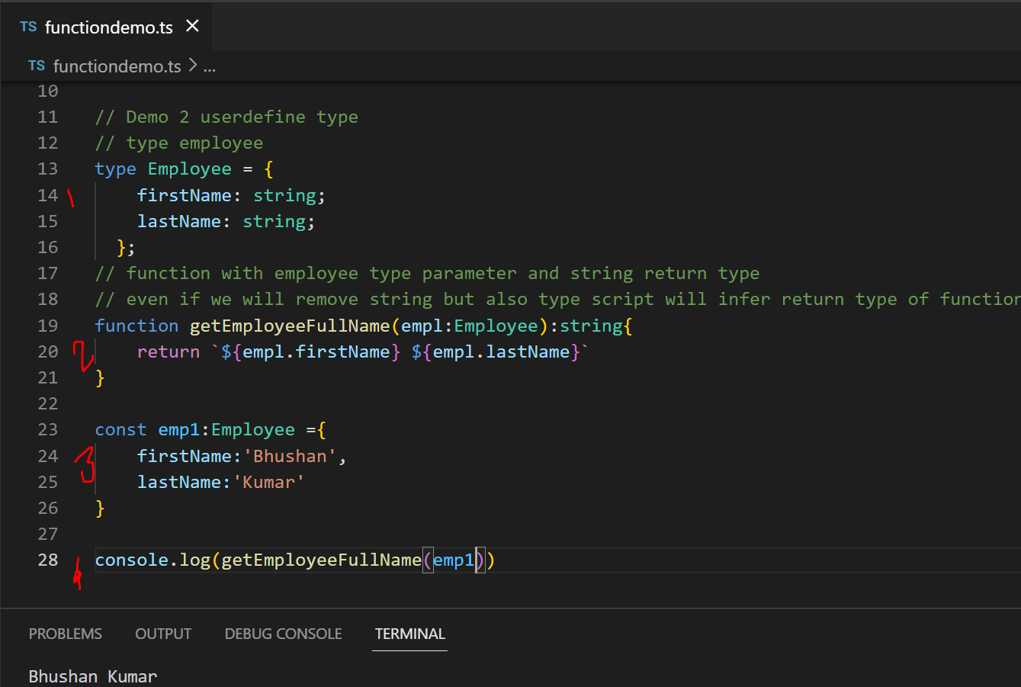
Understanding of Functions
Full Code for previous demo:

Slide 12
Understanding of Functions
Optional Function Parameters in TypeScript.
We have already discussed about optional parameter. Optional parameter are those parameter which mustn’t to be pass while calling function.
To turn a function parameter into an optional one, add the ? modifier right after the parameter name. Given a function parameter param1 with type T, you could make param1 an optional parameter by adding ?, as highlighted in the following:
param1?: T

Slide 13
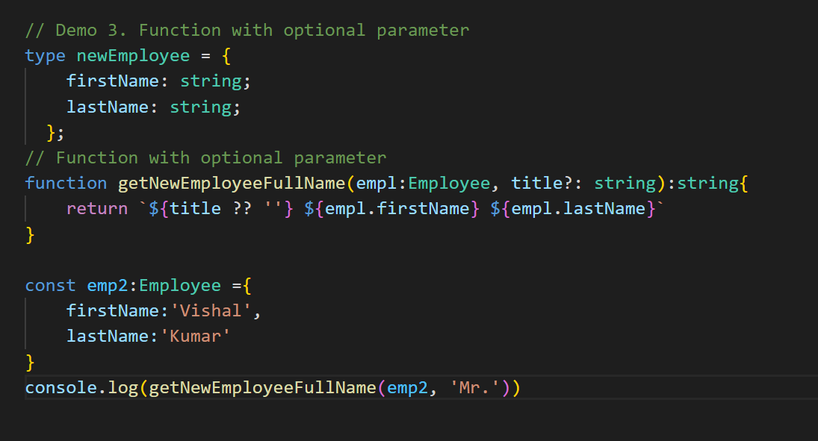
Understanding of Functions
Optional Function Parameters in TypeScript.
Example: same example

Slide 14
Understanding of Functions
Optional Function Parameters in TypeScript.
Example: same example

Slide 15
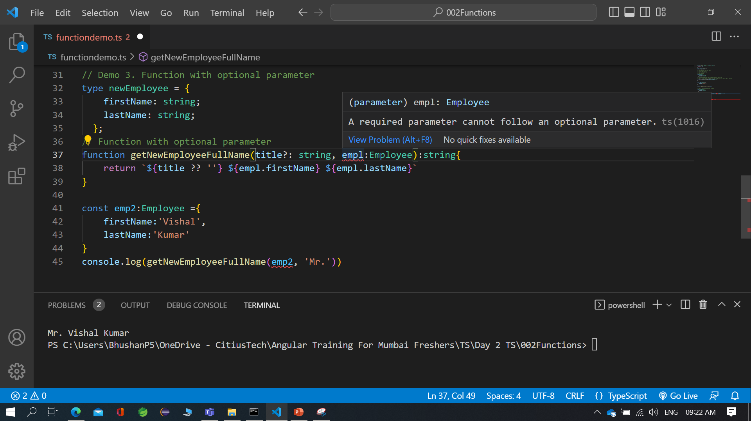
Understanding of Functions
Optional Function Parameters in TypeScript.
Note:
Note that you cannot add an optional parameter before a required one; it must be listed last in the series, as is done with (user: User, prefix?: string). Listing it first would make the TypeScript Compiler return the error 1016:

Slide 16
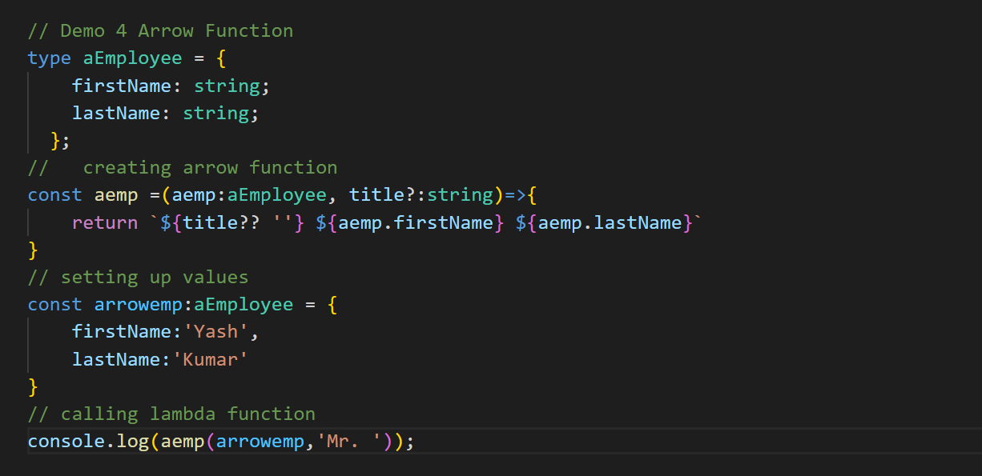
Understanding of Functions
Arrow Function:
Same demo which we have seen for normal function, now, we will see with arrow function

Slide 17
Understanding of Functions
Arrow Function:
Same demo which we have seen for normal function, now, we will see with arrow function

Slide 18
Any Vs Unknown
I Hope you guys know what is any type.
But in type script we have one more type that is called as Unknown.
Let’s understand what is difference between these two.
Let’s see some basic example to understand differences between them.

Slide 19
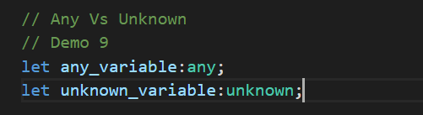
Any Vs Unknown
Here we will see when to use any and when to use any.
Which one will be more suitable for your code.
Let’s try it with two variable
One variable is of type any
Second is of type unknown

Slide 20
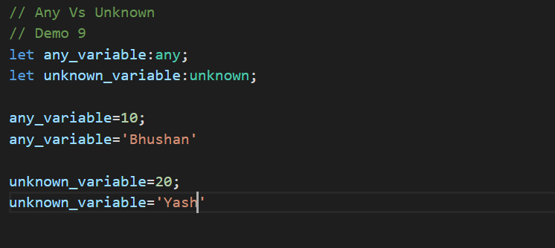
Any Vs Unknown
It means we can assign any type of data to both the variables.
This is we can consider as similarity between them but what are differences?

Slide 21
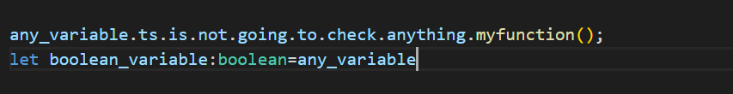
Any Vs Unknown
Variable with any type gives you complete freedom to do anything. You can call anything with it.
Variable with any type can assign to any variable defined with any other type of type script

Slide 22
Any Vs Unknown
Variable with any type gives you complete freedom to do anything. You can call anything with it.
Variable with any type can assign to well defined type variable.

Slide 23
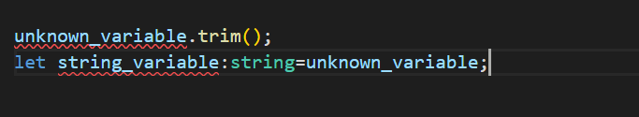
Any Vs Unknown
Unknown is different because for unknown variable we can assign any type of value. But we can’t use it in unsafe manure.
Also you can not access any property on it
And you can’t define to well defined type variable.

Slide 24
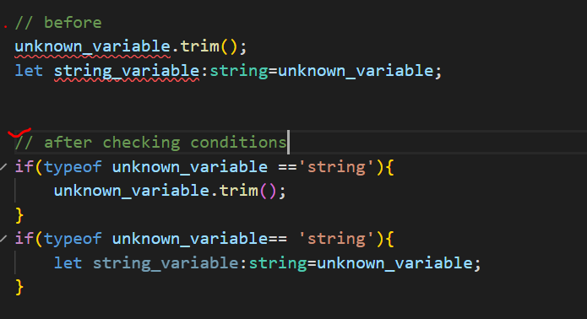
Any Vs Unknown
If further you will have to assign to string then we have to check it’s type then only we can assign.
Example:
So, we can say unknown is safe version of unknown.

Slide 25
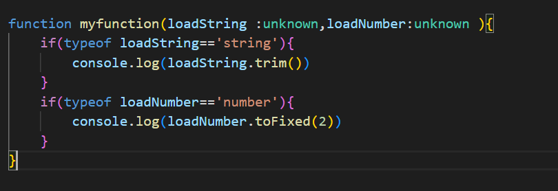
Any Vs Unknown
So, Now we can conclude that any and unknown are same up to certain extent but unknown is safe version of any.
Some time maybe you will be working on project and there will be some function where you are not sure about the type but also for further operations you will have to provide type safety then we can use unknown.

Slide 26
Any Vs Unknown
If we have to provide type safety and avoid runtime errors we will use unknown type and by checking types we can assign them properly with respective type.

Slide 27
Arrays in Type Script
Array has different definition in different programming languages.
JS, PHP –It’s collection of elements of different types
Java, C# - It’s an collection of elements of similar data types.
In type script the concept is the same but here we can achieve both approaches. Let’s see How we can implement arrays of different types, single type, mixed type as well as we will see how we can display all elements in array.

Slide 28
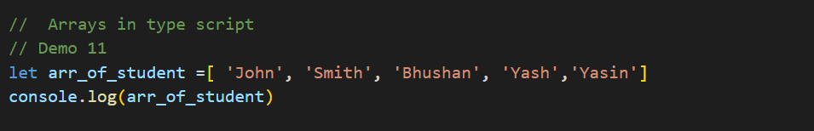
Arrays in Type Script
Basic Syntax for declaring an array what we have seen in java script
Which will print array. But As we are working with type script so, we should have provision to implement type safety here. How to achieve this.

Slide 29
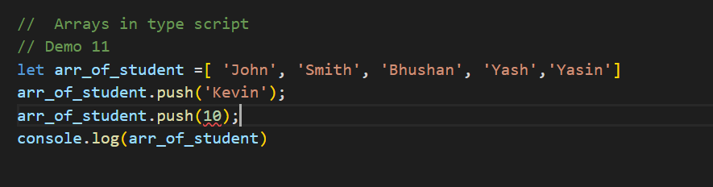
Arrays in Type Script
We will consider same array and try to push two elements. One is string element and second is number type element.
Here, you can see that we got compile time error. While pushing number.
Can anybody tell me what is reason?

Slide 30
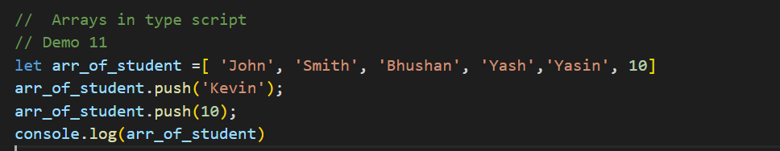
Arrays in Type Script
Again, I will use same array but at the initialization we will put number into it.
So, here I think your doubt must be clear. So, later on if you want to push any boolean value then at the time of initialization a boolean value should present in it then type script will infer this array as mixed array.

Slide 31
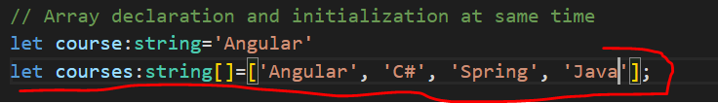

Arrays in Type Script
Let’s understand Array declaration, initialization step by steps and with different ways.
Array declaration and initialization at same time of same type
Array declaration and initialization later of same type

Slide 32


Arrays in Type Script
Let’s understand Array declaration, initialization step by steps and with different ways.
Array declaration and initialization at same time of mixed type
Array declaration and initialization later of mixed type

Slide 33
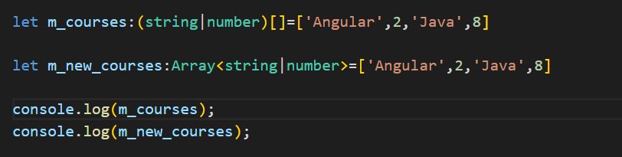

Arrays in Type Script
How to print array?
If we simply have to print all elements as in array then simply we can log it to console.
Output:

Slide 34
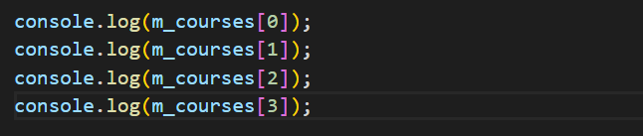

Arrays in Type Script
How to print array?
If we want to get elements one by one then either we can print them with respect to their index
Output:

Slide 35
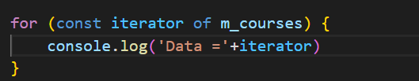
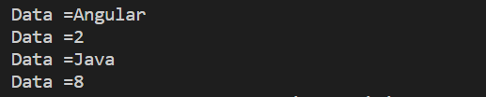
Arrays in Type Script
How to print array?
Or we can use any type of looping to get all elements one by one
Output:

Slide 36
Tuples in Array
In simple words tuples are similar to an array but we can provide some more restrictions which we have achieved in array.
In array, we can create mixed type array but consider a scenario where you are fetching data from API, or from any database and sequence of data are important and in such kind of scenario you will have to provide more restriction on types then tuple will plays important role here.
Using tuple we can provide rather restrict to add element in proper sequence of type.

Slide 37
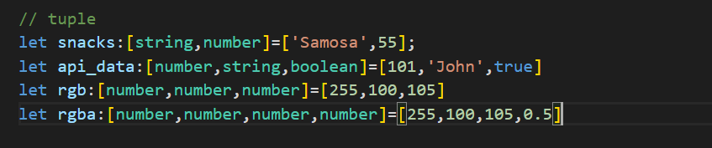
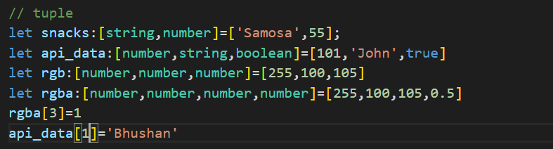
Tuples in Array
Example for declaring an tuple:
As it’s an array so we can update value at certain index.
Example:

Slide 38
OOPS concepts with Type Script
Classes
Objects
Inheritance
Interfaces

